Slide 1
Surgery

Slide 5
Highlights:
Strong signals for memory impairment, psychiatric comorbidity and febrile seizures in TLE group
Other neurological abnormalities in non-TLE group
TLE: 12000 encounters
ExTLE: 3790 encounters

Slide 6
Genetic

Slide 7
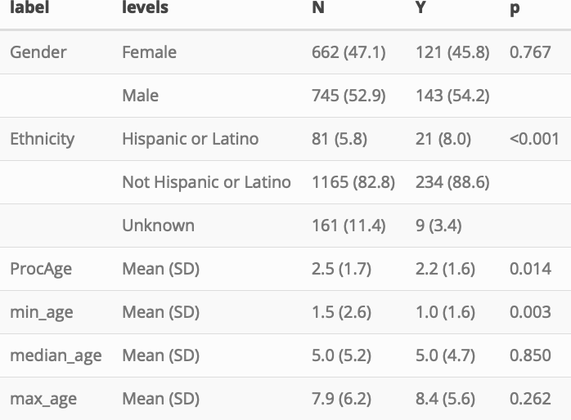

Slide 13
New

Slide 17
SCN1A

Slide 18
CDKL5

